Slide 1
Environmental improvement through product development Step 4: Sketch the stakeholder-network

Slide 2
Step 4: Sketch the stakeholder-network
BACKGROUND
Most environmental efforts in companies focus only on the product or technology aspects
But these efforts are based on a large series of assumptions about the product’s use, users and other stakeholders
Therefore we identify the various stakeholders who are significant for the product’s environmental effects in its lifetime
Notes:
Classic environmental efforts in companies take their point of departure in a product or a technology, directing special attention towards the improvement of the product’s life cycle performance.
A weakness of this approach, is that it is built on a large series of assumptions, because there would otherwise be too many uncertainties to be able to make plausible assessment of the product’s environmental ‘goodness’.
It is therefore important to identify the various stakeholders who are connected to a particular set of activities within which the product plays a role.

Slide 3
Step 4: Sketch the stakeholder-network
BACKGROUND
Environmental impacts often occur in the exchanges between stakeholders – the so-called “stakeholder-network”
Consists of several types of stakeholder:
manufacturing company
component supplier
external designer
freight forwarder
authorities
etc.
In this exercise we sketch the stakeholder-network for the product, to give insight into which stakeholders influence certain environmental impacts.
We will map information exchanges, material flows and the resulting environmental impacts.
Notes:
Environmental impacts often occur in the exchanges between stakeholders, e.g. in negotiations along the supply chain and/or as a result of lack of overview of the roles and responsibilities in the product’s so-called stakeholder-network.
A stakeholder-network consists of several types of stakeholder, for example, the manufacturing company, a component supplier, an external designer, a freight forwarder, the authorities, customers, users, a disposal company, and so on.
To supplement our understanding of the product's environmental impacts, it is important to sketch the stakeholder-network for the product. Sketching the stakeholder-network gives an insight into which stakeholders influence certain environmental impacts. To clarify the relationship between stakeholders and the impacts that occur, one can outline information exchanges, material flows and the resulting environmental impacts.

Slide 4
Step 4: Sketch the stakeholder-network
STEP-BY-STEP APPROACH

Slide 5
Step 4: Sketch the stakeholder-network
STEP-BY-STEP APPROACH
Choose 5 environmental ‘*’ priorities!

Slide 6
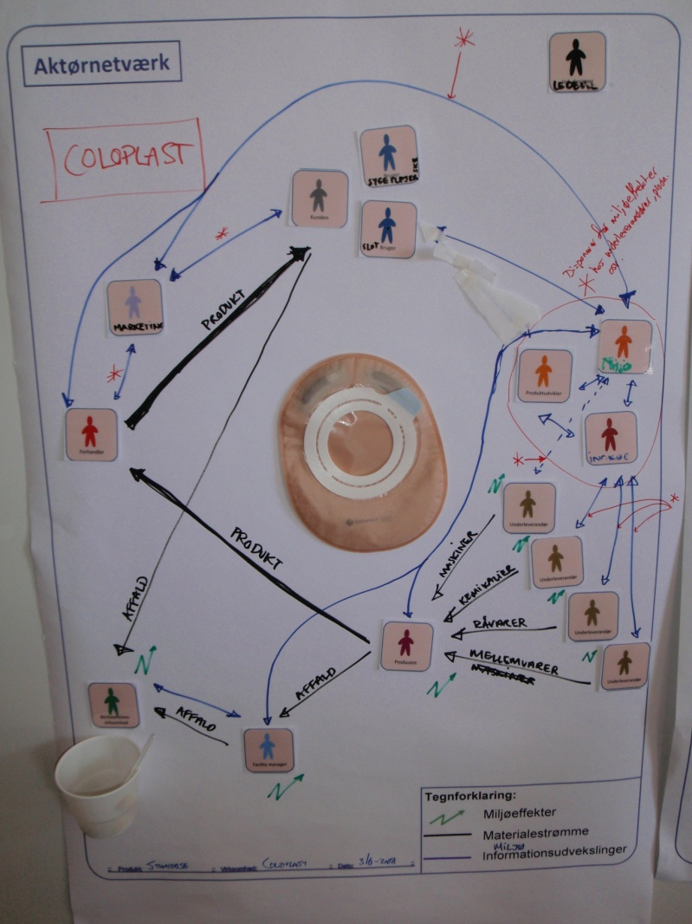
Case example Identification of environmental impacts through the stakeholder-network exercise at Coloplast A/S
Coloplast places a large emphasis on the environment throughout the product life cycle. Since Coloplast’s products are medical devices, environmental considerations must share first place with safety and hygiene. Furthermore Coloplast’s products are not very environmentally burdening in the actual use stage, seen in relation to the rest of the product life cycle.
Coloplast benefitted greatly from the stakeholder-network game, gaining new insights into environmental prioritisation during the development, use and disposal of an ostomy bag.
Example of stakeholder-network at Coloplast, where important environmental impacts have been prioritised, using ‘*’.

Slide 7
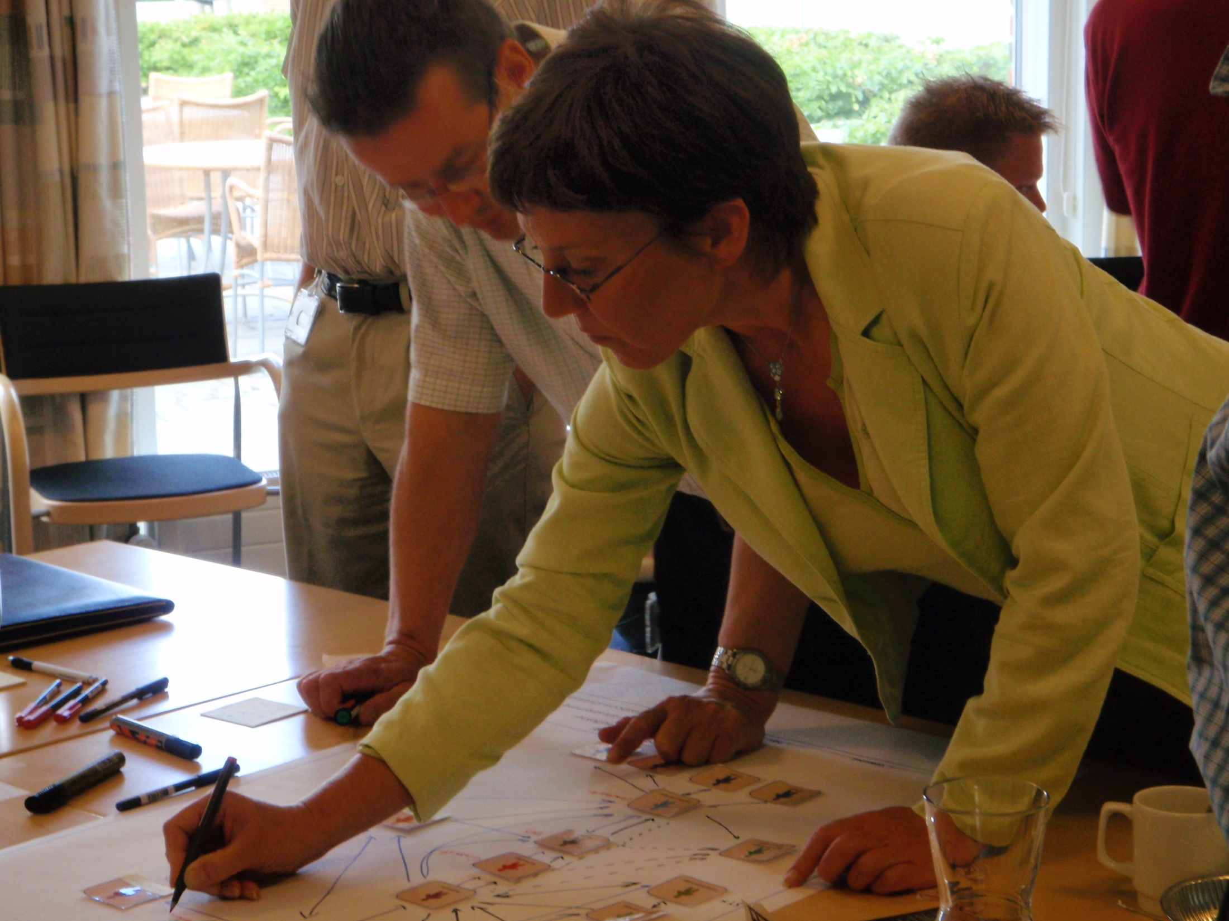
Step 4: Sketch the stakeholder-network

Slide 8
Step 4: Sketch the stakeholder-network
WHY CARRY OUT THIS EXERCISE?
To create an overview of environmental problems’ root causes and improvement potentials
To identify, which stakeholders should be considered in connection with environmental improvements
…or alternatively, which stakeholders should by no means be involved in the environmental task!
“The stakeholder-network exercise gave a good overview of the many stakeholders that we are dealing with. The graphical exercise was good for us to identify not only environmental impacts, but also their initiators. The exercise could not, however, have been carried out in isolation; it was a natural consequence of the previous exercises, which were necessary for us to create an overview of the product's actual environmental impacts.”
[Helle Nystrup, Grundfos Management A/S]
Notes:
The point of the stakeholder-network exercise is to create an overview of environmental problems’ root causes and improvement potentials.
By creating an overview of which stakeholders are connected to the product throughout its life cycle it becomes apparent, which stakeholders should be considered in connection with environmental improvements – or alternatively, which stakeholders should by no means be involved in the environmental task, thus ensuring relevant and likely environmental improvements.

Slide 9
For further information
Tim McAloone
DTU Management Engineering
Engineering Design and Product Development
Building 426, Produktionstorvet, DK-2800 Kgs. Lyngby
Denmark
Telephone (+45) 4525 6270
Homepage www.kp.man.dtu.dk/english/research/areas/ecodesign/guide
Email tmca@man.dtu.dk

