Slide 1
Environmental improvement through product development
Step 2: Create an overview of the environmental impacts

Slide 2
Step 2: Overview of the environmental impacts
BACKGROUND
A product life cycle typically consists of five main stages:
  Raw materials
  Manufacture
  Transport
  Use
  Disposal
Notes:
A product life cycle typically consists of five main stages:
Raw materials covers materials extraction and manufacturing (e.g. plastic granules from crude oil) and semi-finished products (e.g. steel profiles from iron ore), etc.
Manufacture includes the purchase of components, plus the manufacturing and assembly processes, both at suppliers and in in-house production facilities.
Transport covers the entire logistics chain, from suppliers to the end-user and beyond, including distribution activities by ships, trains, planes, trucks, vans and cars.
Use includes the actual usage and possible ancillary products that are necessary for the product to perform its function (e.g. paper filters for a coffee maker). The use stage also includes installation and possible maintenance activities.
Disposal includes reuse/recycling, incineration and landfill. The actual distribution of these disposal options depends on many factors, including regulatory requirements where the product is disposed of, who disposes of the product (an individual or a company), etc. It is obviously difficult to predict how the product will be disposed of, as this stage is typically far in the future.

Slide 3
Step 2: Overview of the environmental impacts
STEP-BY-STEP APPROACH
On a large piece of paper, draw five boxes that correspond to the main product life stages
Brainstorm about all relevant environmental impacts that the product will encounter and organise these in relation to the five product life stages
Use post-it notes – we’ll be moving them a little later
  Write only one environmental impact per post-it note!
The exercise is complete, when the group cannot produce any more ideas.
  Tidy the poster by removing any duplicates.
Using this poster (electronic version available) discuss the product and its use context
Notes:
Draw five boxes that correspond to the main product life stages on a large piece of paper.
Carry out a brainstorming exercise in which everyone in the group writes all relevant environmental impacts, they can think of. Organise these environmental impacts in relation to the five product life stages.
Write everything you think of, regardless of whether you know that an environmental impact is relevant for the product, or whether you just have an idea about its relevance.
Use post-it notes, as these will be moved around a little later. Write only one environmental impact per post-it note!
The exercise is complete, when the group cannot produce any more ideas.
Tidy the poster by removing any duplicates.

Slide 4
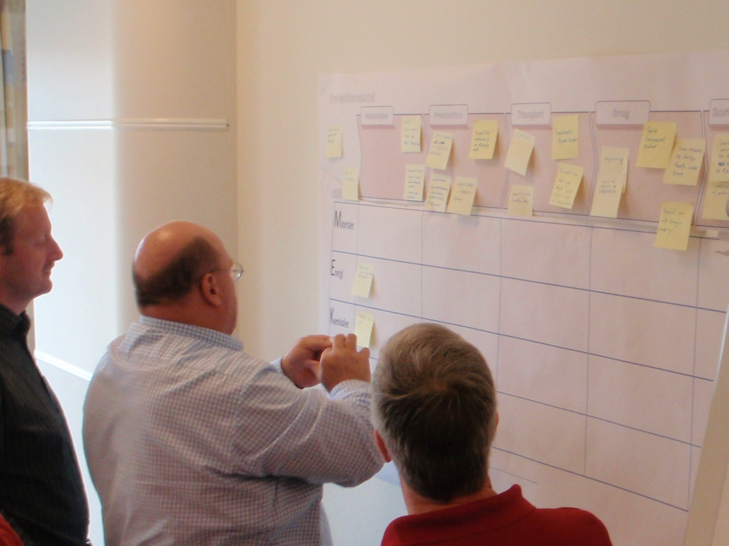
Step 2: Overview of the environmental impacts

Slide 5
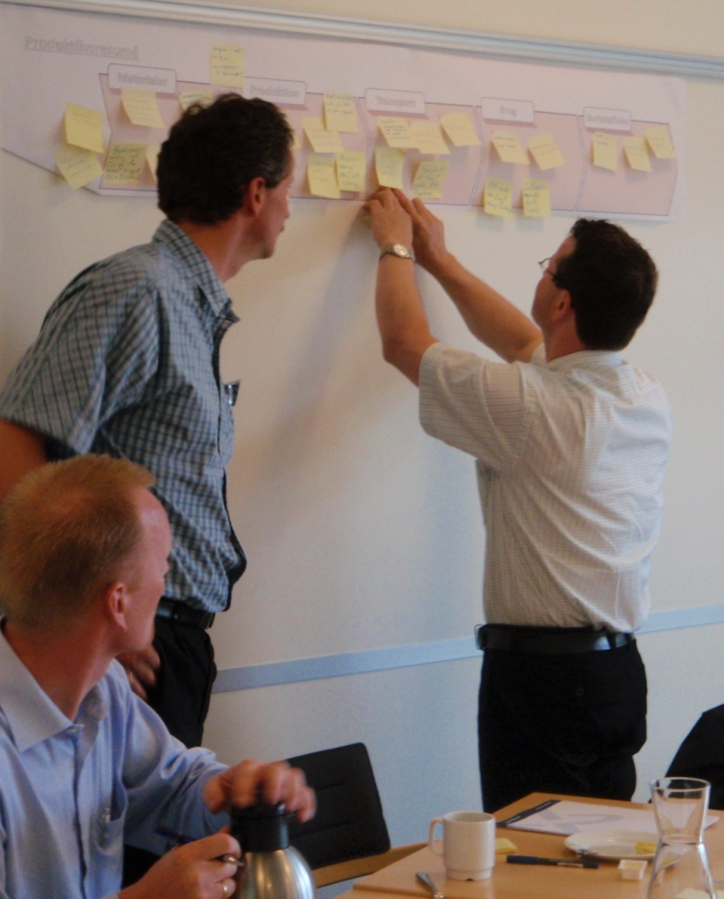
Step 2: Overview of the environmental impacts
WHY CARRY OUT THIS EXERCISE?
In order to allow everyone in the group to contribute with their own experiences and insights
  The group as a whole can quickly create a comprehensive overview
To identify interesting patterns with respect to the product’s environmental impacts in the life cycle
To quickly identify environmental focus areas.
Notes:
This exercise is carried out as a brainstorm, in order to allow everyone in the group to contribute with their own experiences and insights. It will quickly become apparent, that although each individual group member did not have the total overview of all the product’s environmental impacts, the group as a whole could quickly create a fairly complete overview.
When you afterwards look at the product life résumé that has just been created, various patterns can be identified. Maybe one particular product life stage is dominant, as it clearly contains the vast majority of the environmental impacts?
Since the product life résumé shows the environ-mental aspects, distributed over product life stages, it is easy to quickly identify environmental focus areas.

Slide 6


For further information
Tim McAloone
DTU Management Engineering
Engineering Design and Product Development
Building 426, Produktionstorvet, DK-2800 Kgs. Lyngby
Denmark
Telephone (+45) 4525 6270
Homepage www.kp.man.dtu.dk/english/research/areas/ecodesign/guide
Email tmca@man.dtu.dk

